Slide 1
C++ with Cevelop
Enum

Slide 2

What is Enum?
Short for Enumeration
Collection of elements of which the first one has value of 0
The value of the proceeding element increments by one
You can assign values to the element and the proceeding elements with increment off of that

Slide 3
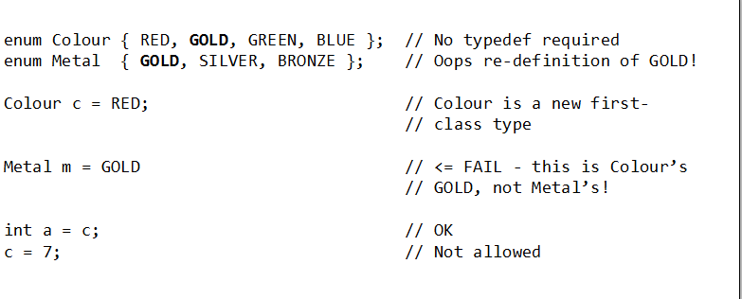
How Do You Implement Enum?
enum [name (optional)] {//elements you want to put in};
If you want to put in two or more elements separate each with a comma

Slide 4
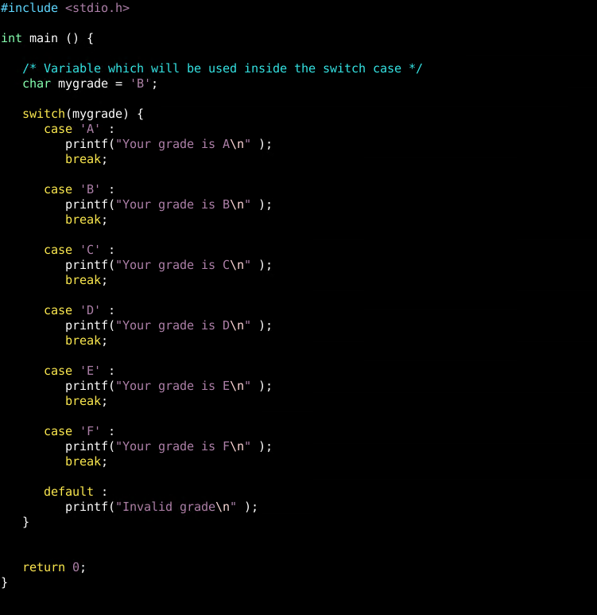
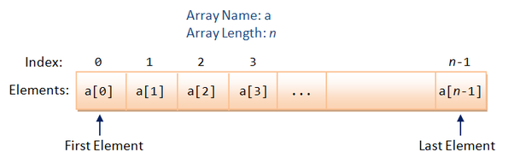
What’s The Use Of Enum?
Array index
Ex. image[FOREST]
Switch Case Statement
Ex switch (cardsuit)
Case SPADE

